Slide 1
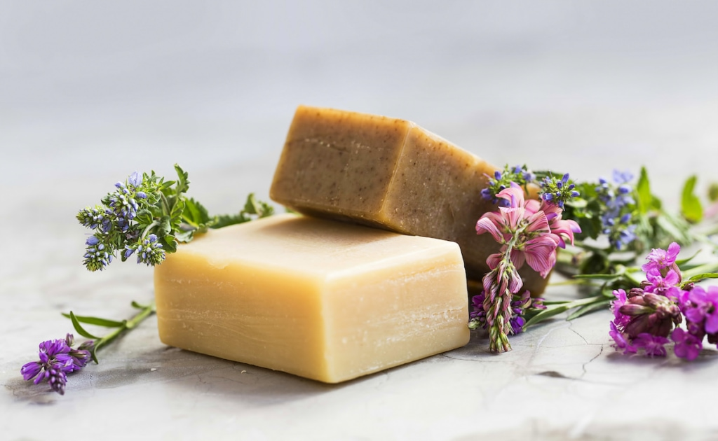

EVALUATING & SHORTLISTING THE BEST PERFORMING FRAGRANCE FOR BAR SOAP
date: 13th january 2023
prepared for:
prepared by: kunal gogri
1 ‒

Slide 2
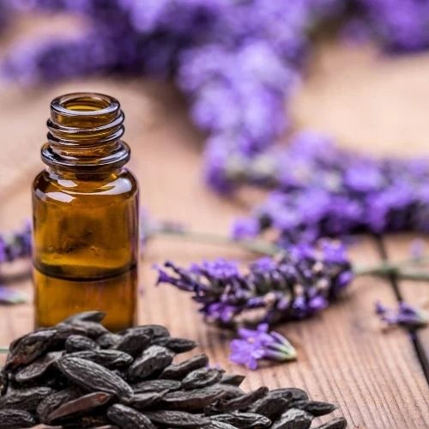
agenda
1. Setting the Context
2. Research Objectives
3. Research Design
4. Performance on Action Standard
5. Detailed findings
6. Summary and Way Forward
7. Appendix
2 ‒

Slide 3
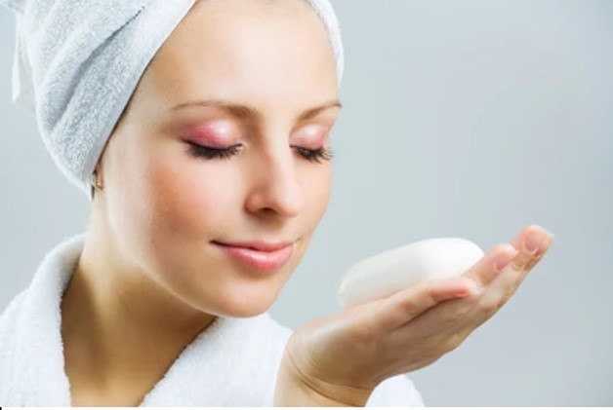
SETTING THE CONTEXT / BUSINESS CHALLENGE
ABC is the market leader in the bar soap category in India.
In order to drive new product development within the category, being the market leader, ABC strives to come up with new product formulations along with new fragrances to provide a satisfactory usage experience for its consumers and sustain its leadership position in the market.
To that effect, ABC approached Firmenich to develop new fragrances for its bar soap.
Firmenich has developed 5 new fragrances which it wishes to evaluate against the benchmark fragrance through a consumer research.
This document contains the detailed findings of this research.
3 ‒

Slide 4
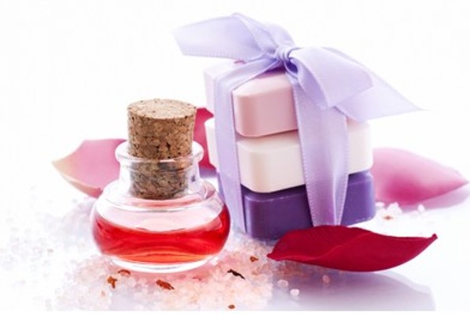
RESEARCH OBJECTIVES
The key objectives of this research are to:
Assess consumer acceptance for the new fragrances when compared to the benchmark fragrance
Evaluate which of the 5 new fragrances emerge as winner and can be prioritized and taken forward to the next stage of development
Identify areas for improvement (if any) for the new fragrances
4 ‒

Slide 5


RESEARCH DESIGN
Females aged 18-55 years
SEC ABC (split as per market representation)
Regular user of bar soap for own use
Those who are currently not:
Suffering from cough & cold
Having a fever
Expecting a child (pregnant)
Allergic to any skin care product and/or smells
Blind/Unbranded product/fragrance test
Total 6 fragrances tested = 5 new fragrances + 1 benchmark fragrance
Interviews were conducted Face to Face at a Central Location
Sequential Monadic approach was followed – every respondent evaluated any 2 out of 6 fragrances.
Target Group
Methodology
 | Sample Size
Total Sample Size achieved | 255

Slide 6
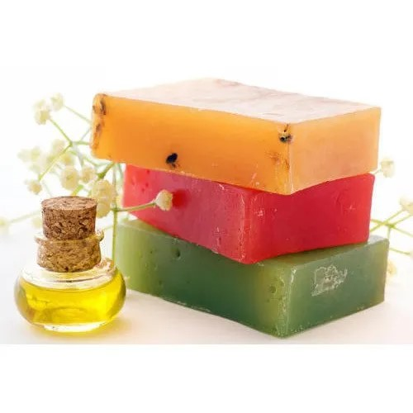
SAMPLE SIZE ACHIEVED
Total respondents interviewed = 255
 | Product code | Read per option
Benchmark fragrance | GV45 | 87
Fragrance 1 | ST69 | 87
Fragrance 2 | PT52 | 87
Fragrance 3 | FE15 | 83
Fragrance 4 | SP27 | 83
Fragrance 5 | ML03 | 83

Slide 7
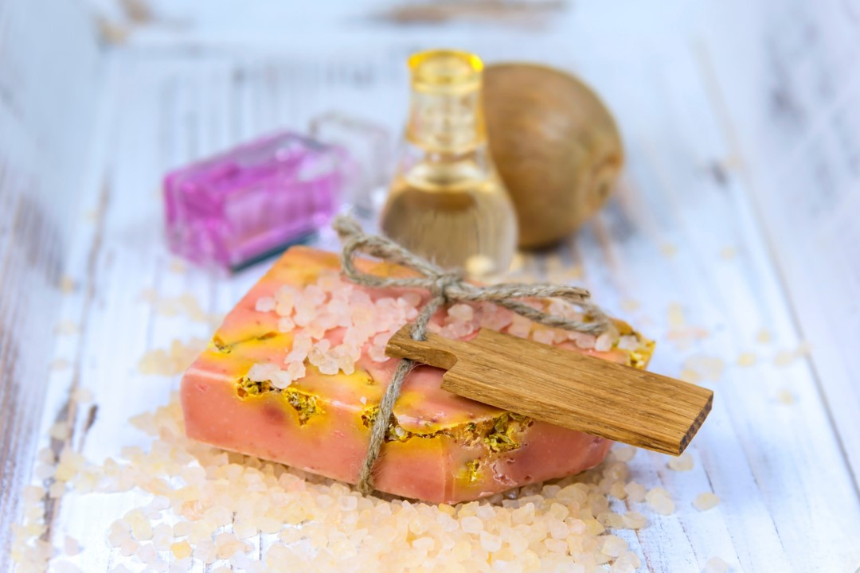
SURVEY FLOW
Recruit respondents at home as per eligibility criteria and invite to CLT
Administer Neutralizer
Expose respondent to 1st fragrance and capture feedback for the same – Neat sniff out of the box, in-wash sniff on lather and Sniff on dry arm stages
Administer Neutralizer
Expose respondent to 2nd fragrance and capture feedback for the same – Neat sniff out of the box, in-wash sniff on lather and Sniff on dry arm stages
7 ‒

Slide 8

RESEARCH CONSIDERATIONS
To avoid order bias, each fragrance was exposed in both positions uniform no. of times by following rotation.
Products were provided in blinded (de-branded) form - similar box packaging and shape/size was followed for all products.
Brand name embedded on the soap was masked to avoid any bias caused due to branding.
Respondents were not allowed to apply any of the following on the day they came to venue for interview:
Flowers in hair
Lotion/Cream with strong fragrance on hands/face/arms
Powders with strong fragrance on hands/face/arms
Perfume/deodorant with strong fragrance
Mehndi/Haldi/Chandan on hands/arms
Avoid cooking with onion/garlic if possible
8 ‒

Slide 9
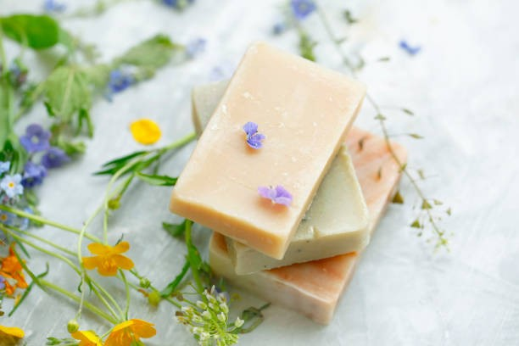
LET US FIRST LOOK AT HOW WELL DO THE NEW FRAGRANCES PERFORM AGAINST THE SET ACTION STANDARD
9 ‒

Slide 10
Performance on Action Standard
Action Standard set: The winning fragrance to have a significant superiority vs. Benchmark at 95% LOC 2-tailed test on “Overall Opinion of Fragrance”
Fragrance PT52 emerges as the best performing fragrance – it achieves superiority to benchmark fragrance at Neat sniff Out of the box and In-wash sniff on lather stages, while being at par at the dry sniff on arm stage.
All other fragrances are inferior to benchmark on atleast one out of the three stages.
Fragrance FE15 and ML03 can be outrightly deprioritized as they are inferior to benchmark fragrance on two or more stages.
Mean Score out of 7.0 | Benchmark GV45 | Frag 1 ST69 | Frag 2 PT52 | Frag 3 FE15 | Frag 4 SP27 | Frag 5 ML03
Sig test notation | A | B | C | D | E | F
Base: All respondents | 87 | 87 | 87 | 83 | 83 | 83
Neat | Overall opinion of fragrance | 4.92 DF | 4.78 | 5.30 A | 4.39 | 4.63 | 4.52
In-Wash | Overall opinion of fragrance | 4.94 DE | 4.72 | 5.34 A | 4.18 | 4.54 | 4.87
Dry | Overall opinion of fragrance | 4.97 BDF | 3.85 | 5.05 | 4.28 | 4.73 | 4.59
Capital letters indicate superiority at 95% LOC vs. Benchmark
Small letters indicate superiority at 90% LOC vs. Benchmark
Sig. superior at 95% LOC
Sig. inferior at 95% LOC

Slide 11
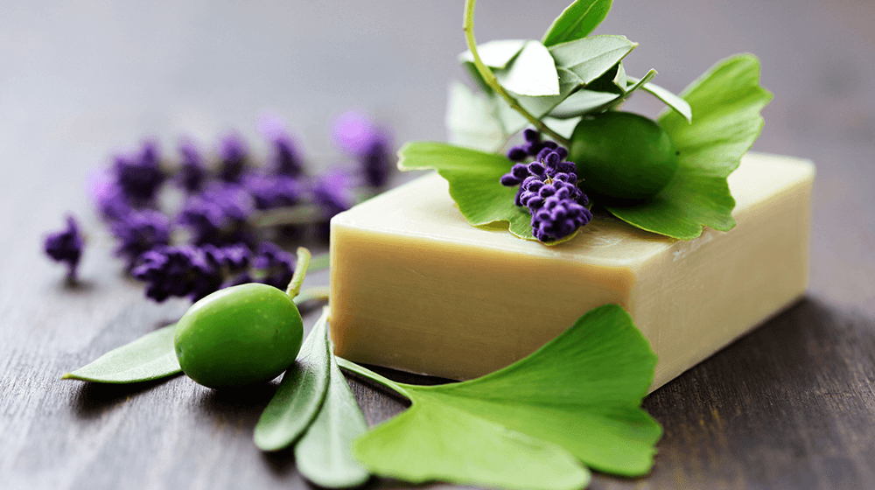
LET US NOW LOOK AT THE PERFORMANCE AT EACH STAGE OF EVALUATION
NEAT SNIFF OUT OF BOX
IN-WASH ON LATHER
SNIFF ON DRY ARM
11 ‒

Slide 12
Performance at Neat Sniff (DRY)
At the neat sniff out of box stage, consumers seem to be most satisfied with the fragrance strength of PT52 – significantly better than benchmark.
However, around 1/3rd consumers find the fragrance of PT52 stronger than they desire – even higher for FE15, SP27 and ML03 fragrances.
Neat Sniff out of box | Benchmark GV45 | Frag 1 ST69 | Frag 2 PT52 | Frag 3 FE15 | Frag 4 SP27 | Frag 5 ML03
Sig test marker | A | B | C | D | E | F
Base: All respondents | 87 | 87 | 87 | 83 | 83 | 83
Top box (%) | 11 | 9 | 26 A | 7 | 8 | 12
Top 2 box (%) | 34 D | 36 | 49 A | 20 | 23 | 31
Overall opinion of fragrance (mean score out of 7.0) | 4.92 DF | 4.78 | 5.30 A | 4.39 | 4.63 | 4.52
Strength of Fragrance
Much + Little weaker (%) | 7 | 9 | 1 | 2 | 6 | 8
Just as you like (%) | 51 D | 60 | 64 a | 37 | 52 | 48
Much + Little stronger (%) | 43 | 31 | 34 | 60 A | 42 | 43
Capital letters indicate superiority at 95% LOC vs. Benchmark
Small letters indicate superiority at 90% LOC vs. Benchmark
Sig. superior at 95% LOC
Sig. superior at 90% LOC
Sig. inferior at 95% LOC
Sig. inferior at 90% LOC

Slide 13
Performance at In-Wash (Lather on arm)
Even at the in-wash stage, consumers seem to be most satisfied with the fragrance strength of PT52 – significantly better than benchmark.
At this stage, around 1/4th consumers find the fragrance of PT52 stronger than they desire – even higher for other new fragrances.
In-Wash | Benchmark GV45 | Frag 1 ST69 | Frag 2 PT52 | Frag 3 FE15 | Frag 4 SP27 | Frag 5 ML03
Sig test marker | A | B | C | D | E | F
Base: All respondents | 87 | 87 | 87 | 83 | 83 | 83
Top box (%) | 15 D | 13 | 20 | 5 | 8 | 16
Top 2 box (%) | 40 D | 36 | 59 A | 25 | 30 | 43
Overall opinion of fragrance (mean score out of 7.0) | 4.94 DE | 4.72 | 5.34 A | 4.18 | 4.54 | 4.87
Strength of Fragrance
Much + Little weaker (%) | 5 | 10 | 0 | 11 | 8 | 10
Just as you like (%) | 56 D | 60 | 76 A | 36 | 51 | 49
Much + Little stronger (%) | 39 | 30 | 24 | 53 A | 41 | 41
Capital letters indicate superiority at 95% LOC vs. Benchmark
Small letters indicate superiority at 90% LOC vs. Benchmark
Sig. superior at 95% LOC
Sig. inferior at 95% LOC

Slide 14
Performance at Sniff on Dry Arm
At the sniff at dry arm stage, PT52 is at par with benchmark on strength of fragrance, whereas this is the stage where most of the new fragrances i.e. ST69, FE15 and ML03 emerge inferior to benchmark.
More than a third consumers find the fragrance of PT52 stronger than they desire.
Dry on Arm | Benchmark GV45 | Frag 1 ST69 | Frag 2 PT52 | Frag 3 FE15 | Frag 4 SP27 | Frag 5 ML03
Sig test marker | A | B | C | D | E | F
Base: All respondents | 87 | 87 | 87 | 83 | 83 | 83
Top box (%) | 15 d | 9 | 26 a | 7 | 12 | 10
Top 2 box (%) | 39 BD | 24 | 43 | 23 | 39 | 37
Overall opinion of fragrance (mean score out of 7.0) | 4.97 BDF | 3.85 | 5.05 | 4.28 | 4.73 | 4.59
Strength of Fragrance
Much + Little weaker (%) | 7 | 20 A | 3 | 5 | 6 | 10
Just as you like (%) | 57 bDf | 44 | 61 | 40 | 47 | 45
Much + Little stronger (%) | 36 | 37 | 36 | 55 A | 47 | 45
Capital letters indicate superiority at 95% LOC vs. Benchmark
Small letters indicate superiority at 90% LOC vs. Benchmark
Sig. superior at 95% LOC
Sig. superior at 90% LOC
Sig. inferior at 95% LOC
Sig. inferior at 90% LOC

Slide 15
SO PT52 IS THE CLEAR WINNER AMONG THE NEW FRAGRANCES.
LET’S UNDERSTAND IF PT52 NEEDS ANY IMPROVEMENT
15 ‒

Slide 16
Strength of Fragrance – Penalty Analysis
PT52 is getting penalized for having stronger than desired fragrance at each of the 3 stages of evaluation.
Those finding the fragrance stronger than they like are rating the Overall Fragrance significantly lower than those who find the fragrance just as they like.
Penalty index
-1.13
Neat out of box
In-Wash
-1.16
Sniff at Dry arm
-1.56
Capital letters indicate superiority at 95% LOC vs. Benchmark
Small letters indicate superiority at 90% LOC vs. Benchmark

Slide 17

Penalty Analysis OVERVIEW
(TO IDENTIFY IMPROVEMENT AREAS FOR PRODUCT)
ILLUSTRATION ONLY
Core business question
Penalty Analysis Output
Penalty Consideration
Is my product’s profile acceptable to consumers? If not, how can it be improved?
Desired research outcomes
Prioritize product deficiencies by assessing their impact on acceptance
Garner direction and explicit guidance for making product improvements
Methodology
Penalty
Penalty
There needs to be a substantial decline in overall liking -- in other words, the penalty must be of a size sufficient to cause a difference in overall liking versus those saying the product is “just right” on the characteristic. The below are basic guidelines :
Fragrance
Colour
Size
Too Weak
Too Light
Too Small
-1.00
NA
NA
Too Strong
Too Dark
Too Big
NA
NA
NA
If 75% or more of the sample indicates that the product is “Just Right” on an attribute, no modifications are indicated. The 75% cut-off point is used for packaged goods.
The product is being penalized for being weaker than desired on Fragrance, leading to an adverse impact on its Overall Liking
Penalty Analysis Overview
Penalty Analysis is a Micro level driver analysis that determines the “penalty” a product pays for not being “Just Right” on a particular characteristic.
Identifies attributes which, if fixed, could improve consumer acceptance
Determines the direction for change of the attribute needed.
Penalty Analysis utilizes “Just Right” ratings along with a
measure of overall acceptance to determine whether:
If deficiencies exist (i.e. ≥ 20% of respondents say “too little” or “too much” of a specific attribute)
If those deficiencies result in decreased acceptability i.e. penalty of -0.80 to -1.00 or higher

Slide 18

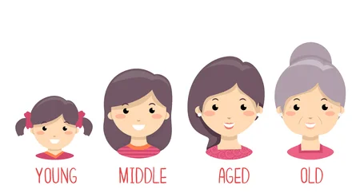


Profiling (Those who find PT52’s fragrance JUST AS THEY LIKE)
SEC A (20%)
SEC B (11%)
SEC C (70%)
 | %
18-25 | 30
26-30 | 24
31-35 | 34
36-40 | 9
41-45 | 5
46-50 | 0
51-55 | 2
Early Adopters
Among first one to buy product with new fragrance
(63%)
Fragrance Seekers
Fragrance being Main + One of the main reason
(79%)

Slide 19
LET’S UNDERSTAND WHICH CHARACTERISTICS EMERGE AS KEY DRIVERS OF OVERALL FRAGRANCE and
HOW DOES PT52 + OTHER FRAGRANCES PERFORM ON THESE DRIVERS
19 ‒

Slide 20
Drivers of Overall Fragrance – Neat out of box
Sweet, Fruity, Soft, Citrus & Fresh emerge as top drivers of Overall Fragrance at the neat out of box stage.
Characteristics | Drive-ability
Sweet | 0.250
Fruity | 0.215
Soft | 0.210
Citrus | 0.175
Fresh | 0.164
Top Drivers
In hierarchical order
Characteristics | Drive-ability
Natural | 0.152
Clean | 0.147
Floral | 0.134
Creamy | 0.129
Light | 0.117
Feminine | 0.098
Pure | 0.097
Secondary Drivers
In hierarchical order
Drivers run using Jaccard Coefficient keeping Overall Fragrance as dependent variable

Slide 21
Drivers of Overall Fragrance – Neat out of box
Characteristics | Drive-ability
Sweet | 0.250
Fruity | 0.215
Soft | 0.210
Citrus | 0.175
Fresh | 0.164
Natural | 0.152
Clean | 0.147
Floral | 0.134
Creamy | 0.129
Light | 0.117
Feminine | 0.098
Pure | 0.097
Sticky Sweet | 0.097
Soapy | 0.087
Edible | 0.077
New | 0.073
Aggressive | 0.067
Green | 0.067
Caring | 0.065
Artificial | 0.064
Baby | 0.059
Neutral | 0.034
Sour | 0.030
Antiseptic | 0.030
Classical | 0.029
Overpowering | 0.028
Masculine | 0.016
Moisturizing | 0.006
Drivers run using Jaccard Coefficient keeping Overall Fragrance as dependent variable

Slide 22
Fragrance Characteristics – Neat out of box
PT52 has a distinctively strong association with Sweet, Fruity & Citrus characteristics which drive Overall Fragrance.
ST69 has a strong association with Soft characteristic whereas Fresh is not distinctively associated with any fragrance.
ST69
Soft
Floral
SP27
Soapy
Overall Fragrance
Green
Light
Creamy
GV45
Clean
Caring
Pure
Natural
Fresh
Edible
Classical
Neutral
Artificial
Feminine
Moisturizing
Sticky Sweet
Masculine
Baby
New
PT52
Sweet
Overpowering
Fruity
Sour
ML03
Aggressive
Citrus
Antiseptic
13.6 %
FE15
64.4 %

Slide 23
Drivers of Overall Fragrance – In Wash
Fresh, Soft, Sweet, Fruity & Natural emerge as top drivers of Overall Fragrance at the in-wash stage.
Characteristics | Drive-ability
Fresh | 0.258
Soft | 0.250
Sweet | 0.247
Fruity | 0.240
Natural | 0.232
Top Drivers
In hierarchical order
Characteristics | Drive-ability
Floral | 0.184
Creamy | 0.153
Citrus | 0.132
Caring | 0.132
Light | 0.124
Clean | 0.122
Secondary Drivers
In hierarchical order
Drivers run using Jaccard Coefficient keeping Overall Fragrance as dependent variable

Slide 24
Drivers of Overall Fragrance – In Wash
Characteristics | Drive-ability
Fresh | 0.258
Soft | 0.250
Sweet | 0.247
Fruity | 0.240
Natural | 0.232
Floral | 0.184
Creamy | 0.153
Citrus | 0.132
Caring | 0.132
Light | 0.124
Clean | 0.122
Sticky Sweet | 0.118
New | 0.111
Edible | 0.103
Baby | 0.102
Pure | 0.084
Soapy | 0.082
Green | 0.081
Feminine | 0.080
Moisturizing | 0.075
Overpowering | 0.061
Classical | 0.057
Neutral | 0.056
Aggressive | 0.048
Artificial | 0.047
Antiseptic | 0.022
Sour | 0.017
Masculine | 0.009
Drivers run using Jaccard Coefficient keeping Overall Fragrance as dependent variable

Slide 25
Fragrance Characteristics – In-wash
PT52 has a distinctively strong association with Soft, Sweet & Fruity characteristics which are top drivers of Fragrance liking.
Fresh which is the topmost driver at this stage is a bit of a white space which can be further explored with the winning fragrance.
FE15
Antiseptic
Aggressive
Citrus
Overpowering
PT52
Green
Sour
Soft
Fruity
Edible
Pure
Sweet
Masculine
Clean
Light
Artificial
Caring
Moisturizing
Sticky Sweet
Overall Fragrance
New
Neutral
Classical
Feminine
Natural
Soapy
Baby
SP27
GV45
ML03
Floral
Fresh
ST69
13.2 %
72.8 %
Creamy

Slide 26
Drivers of Overall Fragrance – Dry on arm
Fruity, Natural, Sweet & Fresh emerge as top drivers of Overall Fragrance at the dry on arm stage.
Characteristics | Drive-ability
Fruity | 0.271
Natural | 0.240
Sweet | 0.231
Fresh | 0.202
Top Drivers
In hierarchical order
Characteristics | Drive-ability
Floral | 0.169
Creamy | 0.164
Soft | 0.162
Sticky Sweet | 0.157
Caring | 0.131
Clean | 0.129
Pure | 0.122
Secondary Drivers
In hierarchical order
Drivers run using Jaccard Coefficient keeping Overall Fragrance as dependent variable

Slide 27
Drivers of Overall Fragrance – Dry on arm
Characteristics | Drive-ability
Fruity | 0.271
Natural | 0.240
Sweet | 0.231
Fresh | 0.202
Floral | 0.169
Creamy | 0.164
Soft | 0.162
Sticky Sweet | 0.157
Caring | 0.131
Clean | 0.129
Pure | 0.122
New | 0.112
Citrus | 0.108
Baby | 0.102
Light | 0.095
Edible | 0.092
Moisturizing | 0.089
Overpowering | 0.082
Feminine | 0.068
Classical | 0.053
Green | 0.051
Neutral | 0.051
Soapy | 0.043
Aggressive | 0.038
Artificial | 0.029
Antiseptic | 0.020
Sour | 0.015
Masculine | 0.010
Drivers run using Jaccard Coefficient keeping Overall Fragrance as dependent variable

Slide 28
Fragrance Characteristics – Dry on arm
PT52 has a distinctively strong association with Fruity & Sweet characteristics which are top drivers of Fragrance liking.
Natural is not distinctively associated with any fragrance.
ST69
Soft
Light
Antiseptic
FE15
Clean
Pure
Sweet
Neutral
New
Citrus
Sour
PT52
Green
Natural
Aggressive
Overpowering
Moisturizing
Artificial
Feminine
Sticky Sweet
ML03
Masculine
Edible
Fruity
Creamy
Floral
Baby
Soapy
Classical
GV45
Caring
SP27
Fresh
19.6 %
57.1 %
Overall Fragrance

Slide 29
Fragrance Impression (Neat out of box)
PT52 performs significantly better than benchmark on Skin Care & Freshness benefits.
 | Benchmark GV45 | Frag 1 ST69 | Frag 2 PT52 | Frag 3 FE15 | Frag 4 SP27 | Frag 5 ML03
Sig test marker | A | B | C | D | E | F
Base: All respondents | 87 | 87 | 87 | 83 | 83 | 83
Family/Health Smells like a product, claiming antibacterial activity and protection of health | 18 | 16 | 26 | 28 | 20 | 29 a
Experiential Gives me a special fragrance experience in the shower | 25 | 25 | 25 | 19 | 17 | 25
Skin Care Will nourish and moisturize my skin | 26 E | 29 | 38 a | 16 | 12 | 31
Freshness Will provide me with a fresh feeling | 26 | 30 | 43 A | 17 | 19 | 33
Capital letters indicate superiority at 95% LOC vs. Benchmark
Small letters indicate superiority at 90% LOC vs. Benchmark
Sig. superior at 95% LOC
Sig. superior at 90% LOC
Sig. inferior at 95% LOC
Sig. inferior at 90% LOC

Slide 30
Fragrance Fit with product attributes (Neat out of box)
PT52 has a distinctively strong fit with “can use for every shower” & “for entire family”, making it a universally accepted fragrance. ST69 has a strong association with “contains natural Ingredients”.
FE15
Will relax me
Use in morning to wake up
Used for sensitive skin
Gives me energy
Will give feeling of well-being
Shower in evening before go to bed
PT52
SP27
Might dry out my skin
Respect and protect skin
ML03
Is for all the family
I can use for every shower
ST69
GV45
17.4 %
64.7 %
Contains natural ingredients

Slide 31
Feeling while smelling
PT52 has a positive association with the feeling of Sensual & Romantic – perhaps due to the skew towards younger age group. It also has positive association with Mouth-watering, Interested & Refreshed.
Good to see PT52 being the only fragrance negatively associated with pessimistic feeling of Disgusted, Melancholic & Unpleasantly surprised. However it has a strong association with “Famished” which could be worked upon.
 | Benchmark GV45 | Frag 1 ST69 | Frag 2 PT52 | Frag 3 FE15 | Frag 4 SP27 | Frag 5 ML03
Sig test marker | A | B | C | D | E | F
Base: All respondents | 87 | 87 | 87 | 83 | 83 | 83
Disgusted | 2.5 | -2.8 | -3.9 | 0.9 | -0.2 | 3.4
Happy | 6.5 | 4.0 | 2.3 | -2.1 | -5.2 | -5.5
Sensual | 0.0 | 0.5 | 3.7 | -2.3 | -0.6 | -1.2
Energetic | -0.8 | -2.7 | -3.2 | 3.6 | -1.9 | 5.0
Soothed | 2.6 | 1.1 | -1.9 | -3.0 | -2.9 | 4.2
Mouth-watering | -3.9 | 2.9 | 6.0 | -4.0 | -1.7 | 0.8
Interested | 1.0 | -2.6 | 4.1 | -5.5 | 4.5 | -1.4
Nostalgic | 2.8 | -1.9 | 2.3 | 0.9 | 2.5 | -6.4
Spiritual Feeling | 0.8 | 2.1 | -3.7 | 0.9 | -0.5 | 0.6
Irritated | 0.4 | -3.2 | -2.8 | 6.4 | 0.0 | -0.8
Pleasantly Surprised | 1.0 | 0.9 | 1.4 | -4.2 | 1.1 | -0.3
Romantic | -1.0 | 0.5 | 3.7 | -1.3 | 0.4 | -2.2
Refreshed | 4.5 | -1.1 | 4.4 | 0.1 | -0.9 | -6.9
Comforted | 0.8 | 1.0 | -2.2 | -0.9 | 2.6 | -1.4
Thirsty | -1.7 | -3.2 | 0.7 | -2.8 | -1.2 | 8.2
Amusement | -3.7 | 0.0 | 0.2 | -1.8 | -1.6 | 6.9
Melancholic | -2.0 | -0.3 | -4.6 | 4.6 | 1.4 | 1.0
Unpleasantly surprised | 0.3 | -1.2 | -3.8 | 2.9 | 1.7 | 0.1
Well-Being | -4.5 | 1.9 | -3.2 | 3.8 | 2.9 | -1.0
Desire | -3.1 | 2.5 | 0.0 | -2.0 | 3.2 | -0.5
Revitalized | -0.4 | -0.9 | -4.9 | 4.0 | 2.1 | 0.2
Relaxed | 0.5 | 4.2 | 0.0 | -2.5 | -3.3 | 1.1
Famished | -1.9 | 1.4 | 5.3 | -0.6 | -1.1 | -3.1
Impressed | 0.3 | -1.8 | 1.9 | 2.0 | -0.6 | -2.0
Sad | -0.9 | -1.0 | -1.5 | 3.2 | -0.8 | 1.0

Slide 32
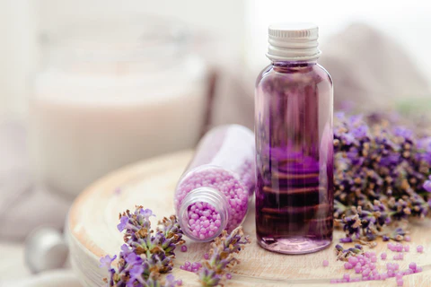
SUMMARY & WAY FORWARD FOR THE BEST PERFORMING FRAGRANCE – PT52
32 ‒

Slide 33
SUMMARY
WAY FORWARD
Only PT52 fragrance meets the action standard of being superior to benchmark at the neat sniff out of box stage and in-wash stages.
However, it fails to meet the action standard at the dry sniff on arm stage where it is at par with benchmark
Depending upon which stage of evaluation is more critical to the business, PT52 can be prioritized for further stages of development.
PT52 gets penalized for having stronger fragrance than desired at all 3 stages of evaluation.
It is recommended to reduce the strength of fragrance for PT52 which should further have a positive impact on Overall Fragrance liking.
Sweet, Fruity & Fresh emerge as the top drivers of Overall Fragrance at all 3 stages of evaluation.
PT52 is distinctively associated with Sweet & Fruity at all 3 stages.
Fragrance Development team can take PT52 forward by building on these strength areas which can be further leveraged at the communication stage.
There is scope to build PT52 fragrance on Freshness characteristic further impacting overall fragrance.

Slide 34
ST69 CAN BE THE NEXT IN LINE CONTENDER WHEREAS FE15 AND ML03 CAN BE DE-PRIORITIZED
34 ‒

Slide 35
ST69 CAN BE NEXT IN LINE CONTENDER
FE15 AND ML03 CAN BE DE-PRIORITIZED
ST69 comes closest to PT52 on fragrance strength at all 3 stages of evaluation. Though is significantly inferior to benchmark on Overall Fragrance at sniff at dry arm stage.
ST69 is distinctively associated with Soft characteristic which is one of the top driver of Fragrance at the neat out of box stage. It also has a positive association with Fresh at the in-wash stage.
ST69 also distinctively owns Antiseptic and Natural Ingredients which could be a space that can be explored with this fragrance option. It is seen as a fragrance which gives feeling of Happy & Relaxed.
FE15 and ML03 fragrances emerge significantly inferior to benchmark fragrance at two or more stages of evaluation, hence, can be outrightly de-prioritized.
FE15 is strongly associated with Aggressive (at both Neat sniff out of box & in wash stages), whereas ML03 has a strong association with Overpowering (neat sniff out of box stage)
FE15 has a positive association with some pessimistic feelings like Irritated & Melancholic whereas ML03 has a positive association with Disgusted and Thirsty.

Slide 36
APPENDIX

Slide 37
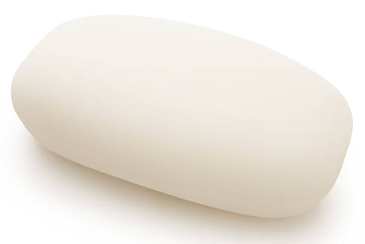
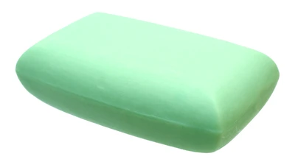
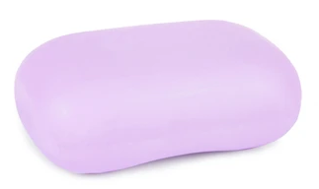
Colour association
PT52 is most preferred in White colour followed by Light Green and Light Purple/Pink colours.
WHITE
(22%)
LIGHT GREEN
(18%)
LIGHT PURPLE/PINK
(17%)
CAUTION: Colour preference might be biased by assuming consumers could make out the colour of the soap from the box

Slide 38
SUPERIORITY check
Vs.
PARITY CHECK
A superiority check is typically conducted at 95% LOC 2-tailed
You know you have an improved product/fragrance vs. your own in-market product/fragrance or vs. benchmark
The higher the confidence level, the more stringent it is to get significant differences. Hence in order to be absolutely sure about test product’s/test fragrance’s superiority, a higher confidence level is set.
A parity check is typically conducted at 80% LOC 1-tailed
Your aim is to be at par with the benchmark – You are not aiming for significant differences with the benchmark
Hence the check is done at 80% LOC which makes significant differences come out more easily thereby making it more stringent to achieve parity
A superiority action standard is typically recommended on following scenarios
New product launch in a not so dominant category (more fragmented)
Improved formulation of an existing in-market product/fragrance
A parity action standard is typically recommended on following scenarios
New product launch vs. a dominant in-market leader
Value improved product/fragrance to be launched as replacement for the current in-market product/fragrance
A superiority check at 95% LOC is typically based on 2-tailed test
While you are checking for superiority, you may end up being at par/inferior with benchmark in consumer’s mind, hence both directions are possible. As a result, a 2-tailed test is conducted.
A parity check at 80% LOC is typically based on 1-tailed test
As you know yours is an inferior product/fragrance and you cannot be superior to benchmark, you just have one direction in mind i.e. parity, hence 1-tailed test.

Slide 39
SEQUENTIAL MONADIC
Vs.
MONADIC
SEQUENTIAL MONADIC DESIGN
Typically done at the initial stage of product evaluation where multiple options are evaluated with the objective of shortlisting the best performing option More sensitive, which brings out the smaller differences between products since its comparative in nature hence useful in prioritizing between multiple prototypes Can also be useful when the objective is cost optimization (silent change to in-market product) Does not depict in-market reality Prone to order bias caused due to strong 1st exposure or 2nd exposure performance.
MONADIC DESIGN
Typically done at the final stage of product evaluation before launch Monadic test simulates in-market reality (natural way of using the products), hence useful to be adopted at the final stage before launch. Best approach when Trial rate needs to be predicted based on Concept/Communication. Lesser fatigue as focus is on one option, hence better quality data can be expected. Higher chances of parity results due to absence of comparative evaluation making it difficult to take final go/no-go decision. Sample size required would be higher than Sequential since one respondent is exposed to only one option.
Pros are highlighted in GREEN and Cons are highlighted in RED

Slide 40
THANK YOU!!!

